Slide 1

Dark Web Monitoring System Leaked Credentials with ML-UI
Presented by :
Lokantik Jain & Kashvi Pandey
Guided by :
Dr. Rimpy Bishnoi
Department of CSE
Techno India NJR Institute of Technology, Udaipur(Raj.)
Date: 09-05-2025

Slide 2

Problem Statement
Cybersecurity threat: Credential leaks on the dark web
Impact: Identity theft, fraud, and compromised privacy
Challenge: Early detection and accurate leak confirmation
Security risks
Detection difficulty
Leaked credentials endanger user accounts
Dark web is vast and encrypted
False positives
Need for reliable confirmation techniques

Slide 3
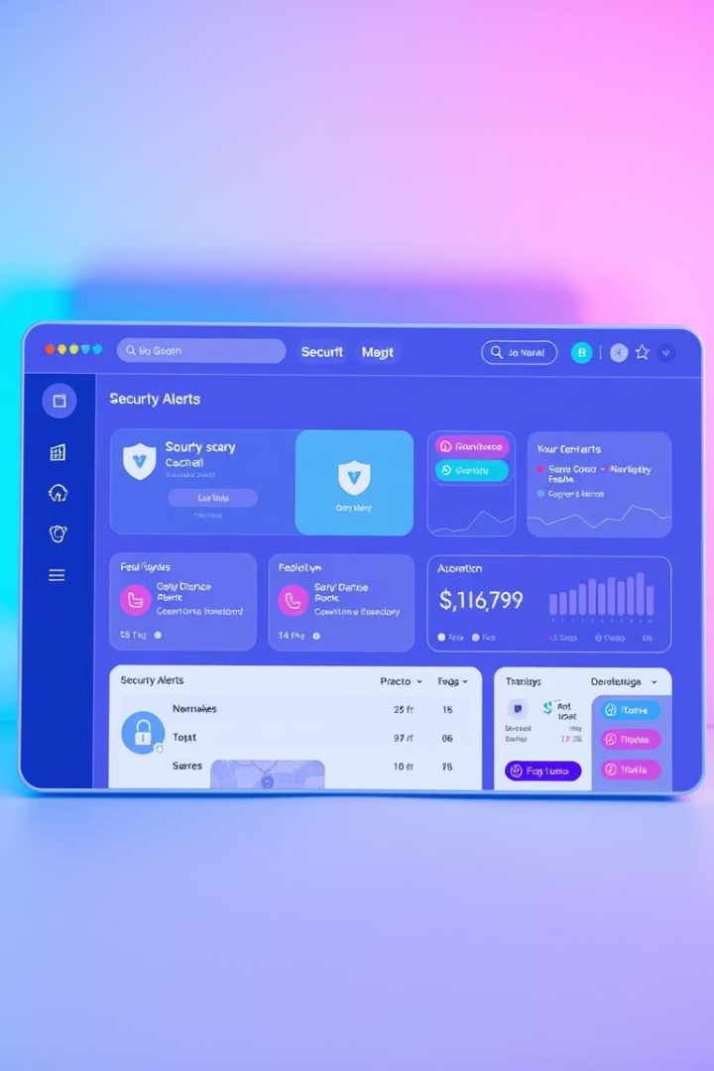
Project Objectives
Leak detection
Identify user credential leaks promptly
ML + pattern matching
Enhance accuracy of leak identification
Real-time alerts
Notify users via Email and Telegram instantly
User interface
Develop an intuitive web-based UI

Slide 4
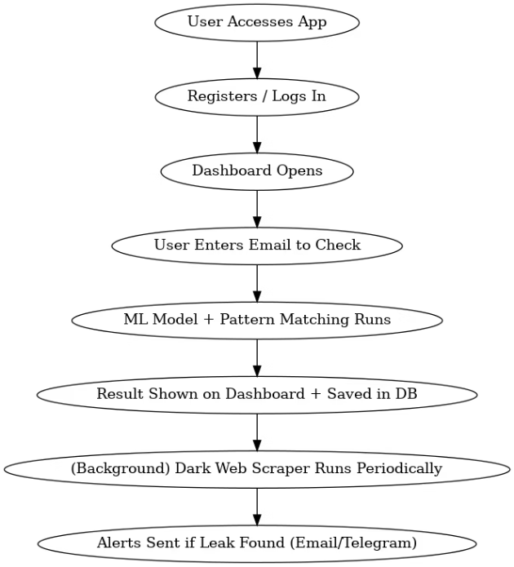
System Architecture Overview
User Interaction
Data Scraper
Machine Learning Model
Alerts Module
Access via Flask web application
Collects credentials from dark web sources
Classifies leaks with logistic regression
Sends notifications via Email and Telegram

Slide 5
Technologies Used
Backend
Frontend
Web Scraping
Python, Flask, SQLite, APScheduler for scheduling
HTML, CSS with Bootstrap framework
Tor network and BeautifulSoup library
Machine Learning
Alerts
Scikit-learn using logistic regression model
Email via SMTP and Telegram Bot API

Slide 6
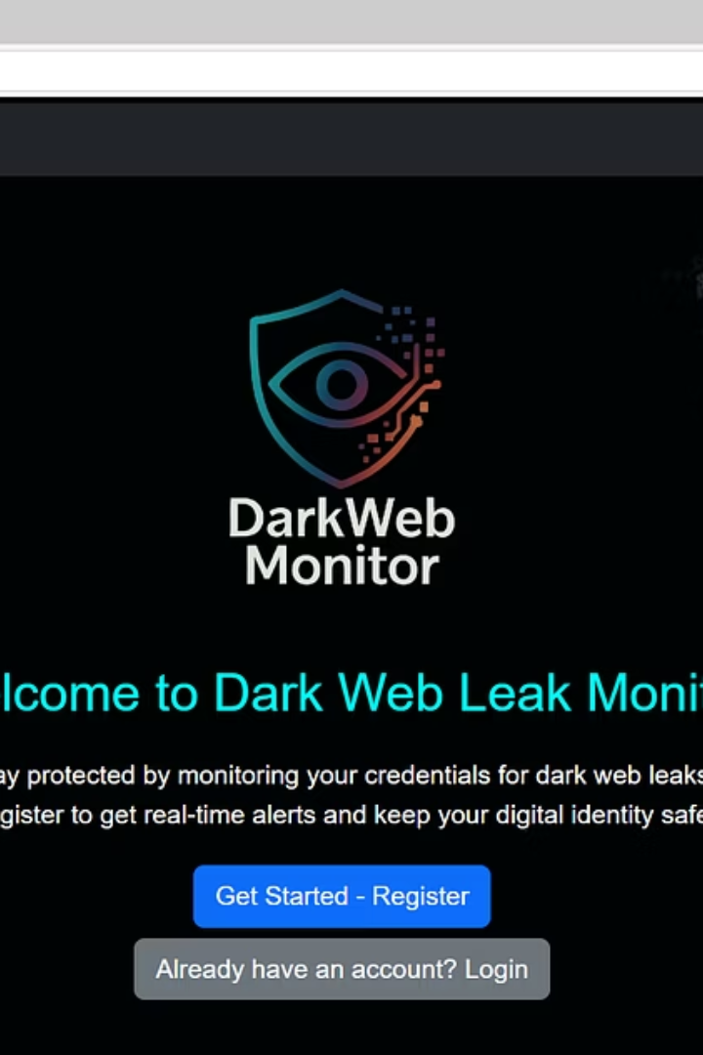
Welcome Page UI Overview
Logo & Project Name
Intro Text
Clear branding for easy recognition
Brief project description for users
Register/Login
Simple buttons for user access

Slide 7
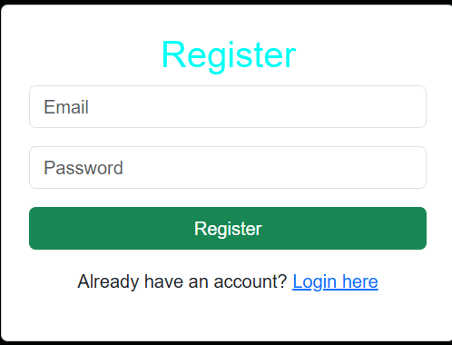
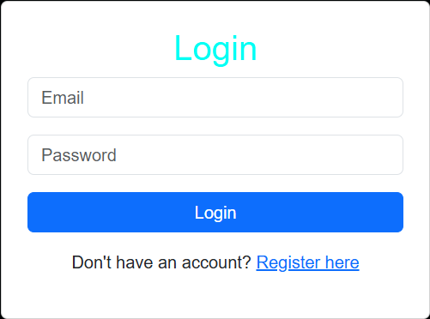
Register & Login Interface
Secure User Handling
Encrypted passwords with validation
Simple Forms
Easy registration and login workflow

Slide 8
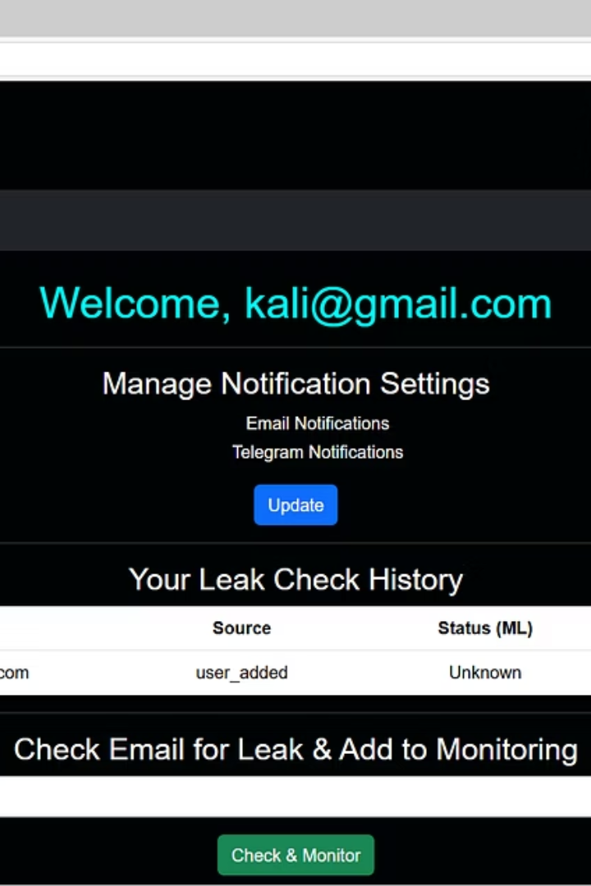
Dashboard UI: Check & Add Credentials
Credential Checking
Users input email to scan for leaks
Adding Credentials
Option to submit new credential data

Slide 9
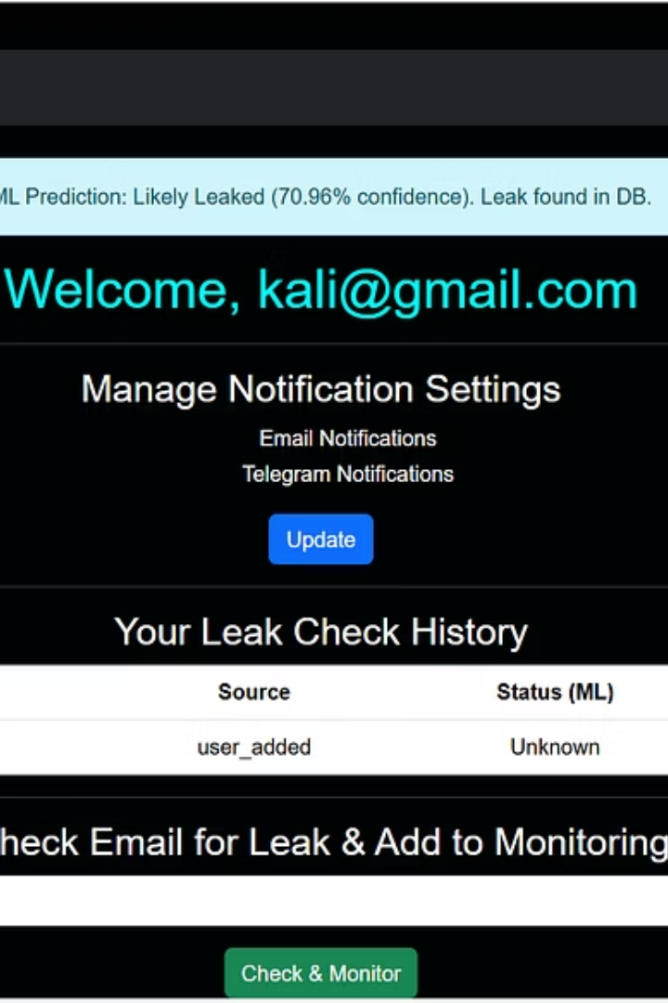
Dashboard UI: Leak History Table
Type
Value
Source
Status (ML)
Timestamp
Email
user@example.com
darkwebsite123.onion
Likely Leaked
2025-05-09 15:30

Slide 10
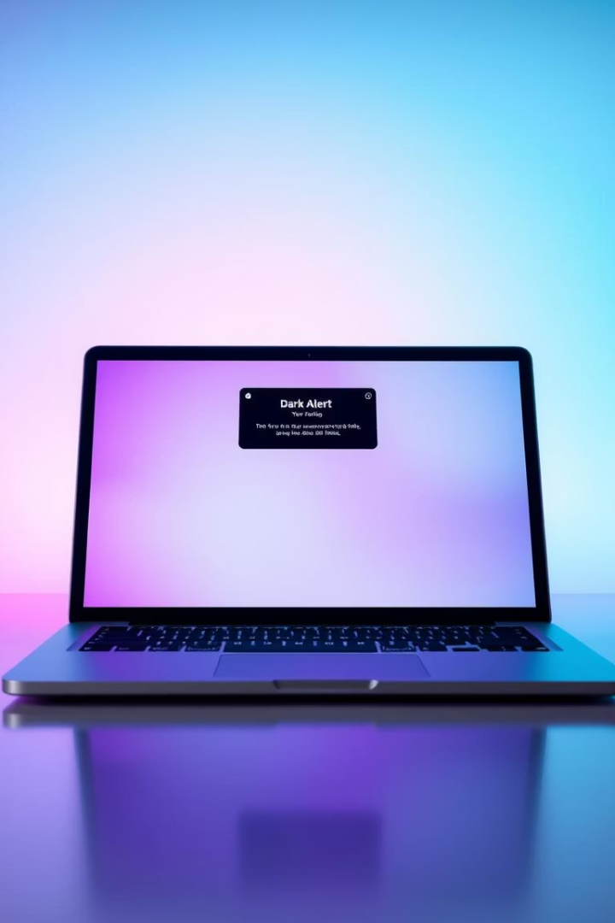
Alerts Notification Example
Instant Alert
User notified immediately of a leak
Alert Content
Details on type, status, source, and time
Recommendations
Password change, enable 2FA, monitor accounts
Delivery Channels
Email and Telegram for critical updates

Slide 11
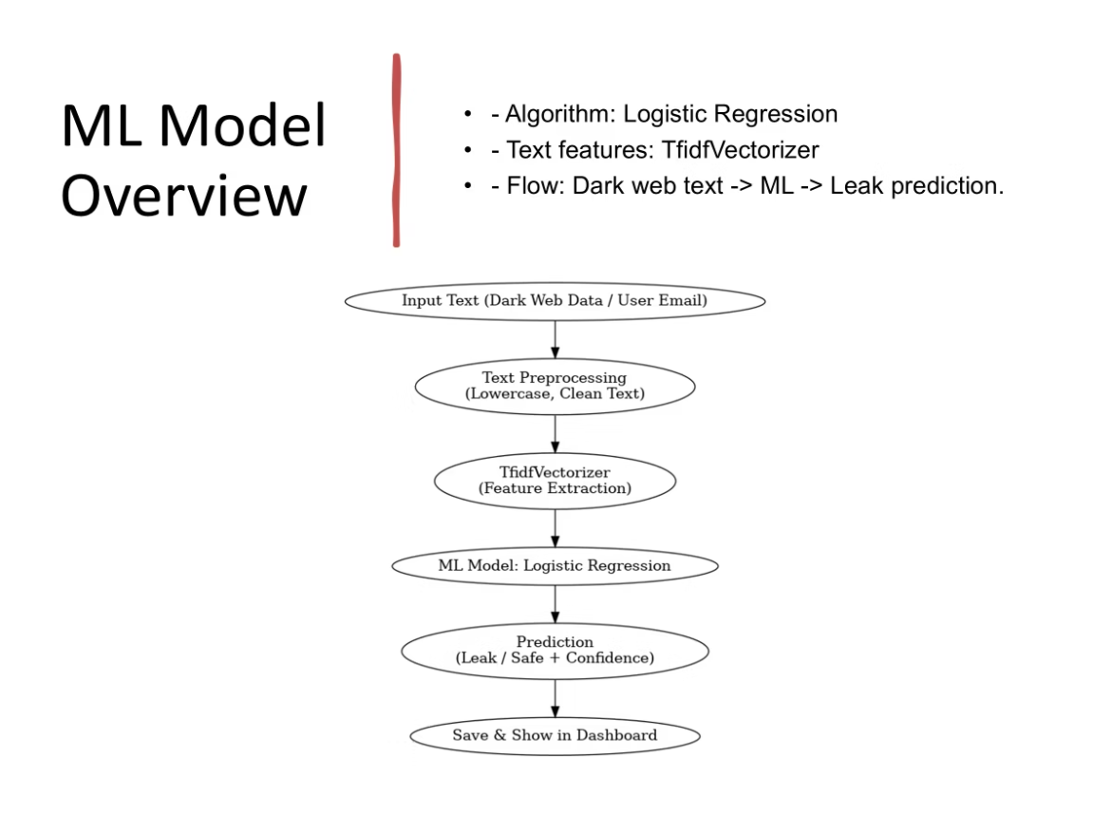
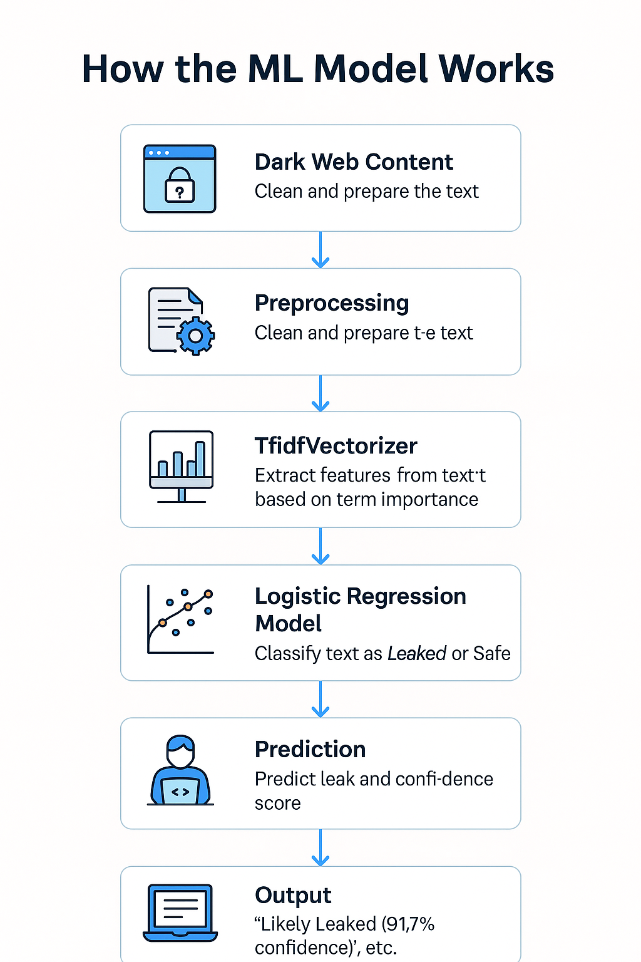

Slide 12
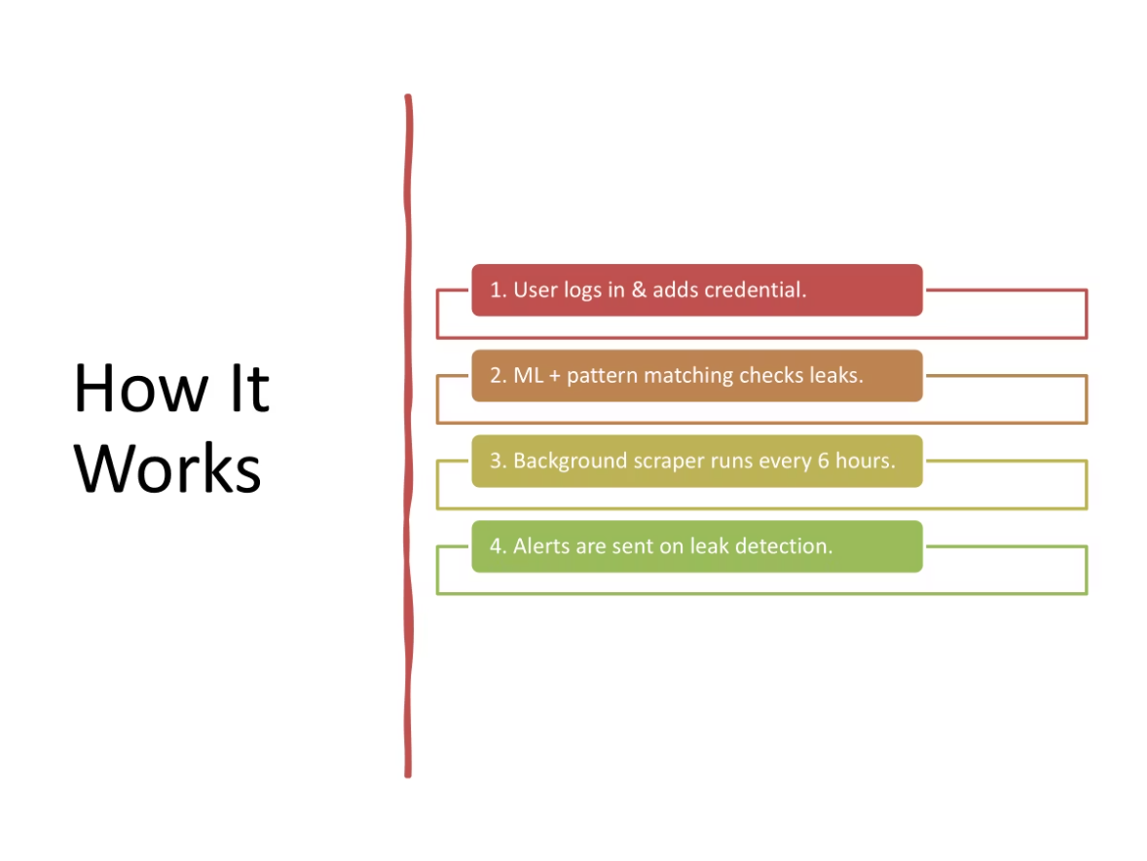

Slide 13
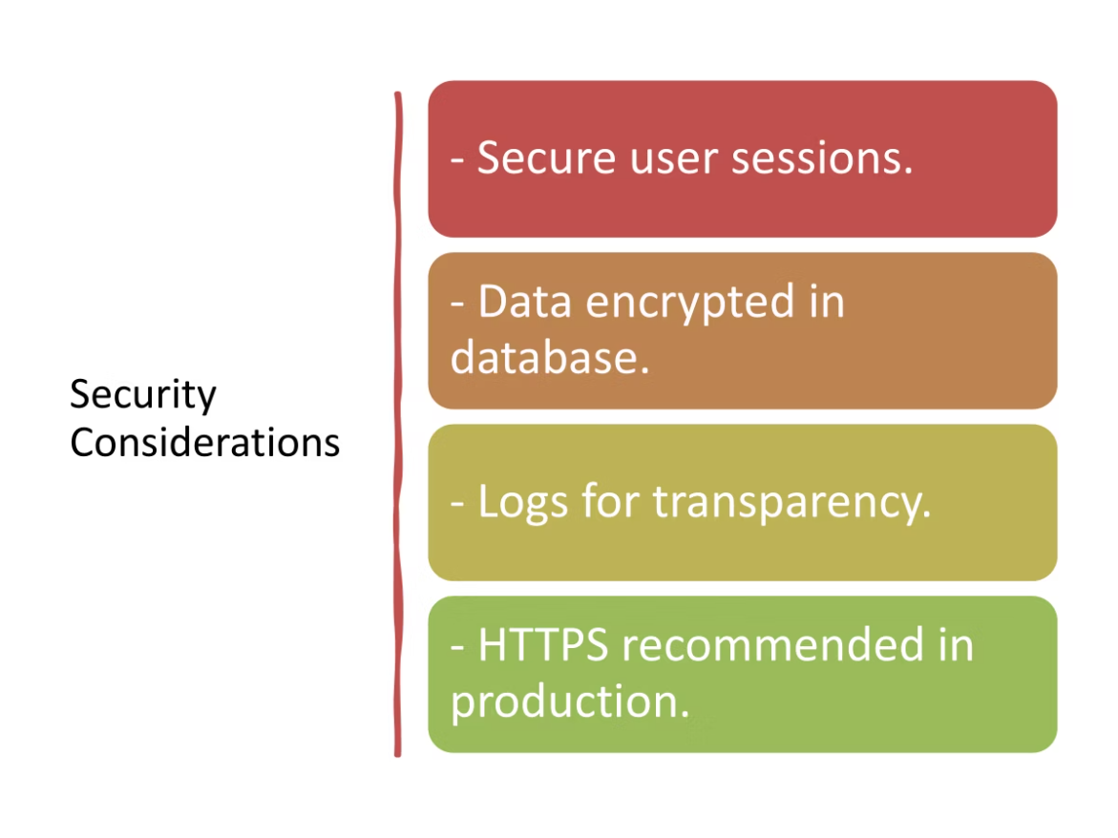

Slide 14
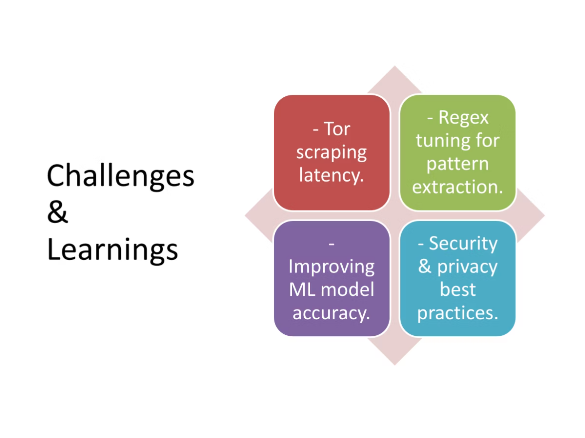

Slide 15
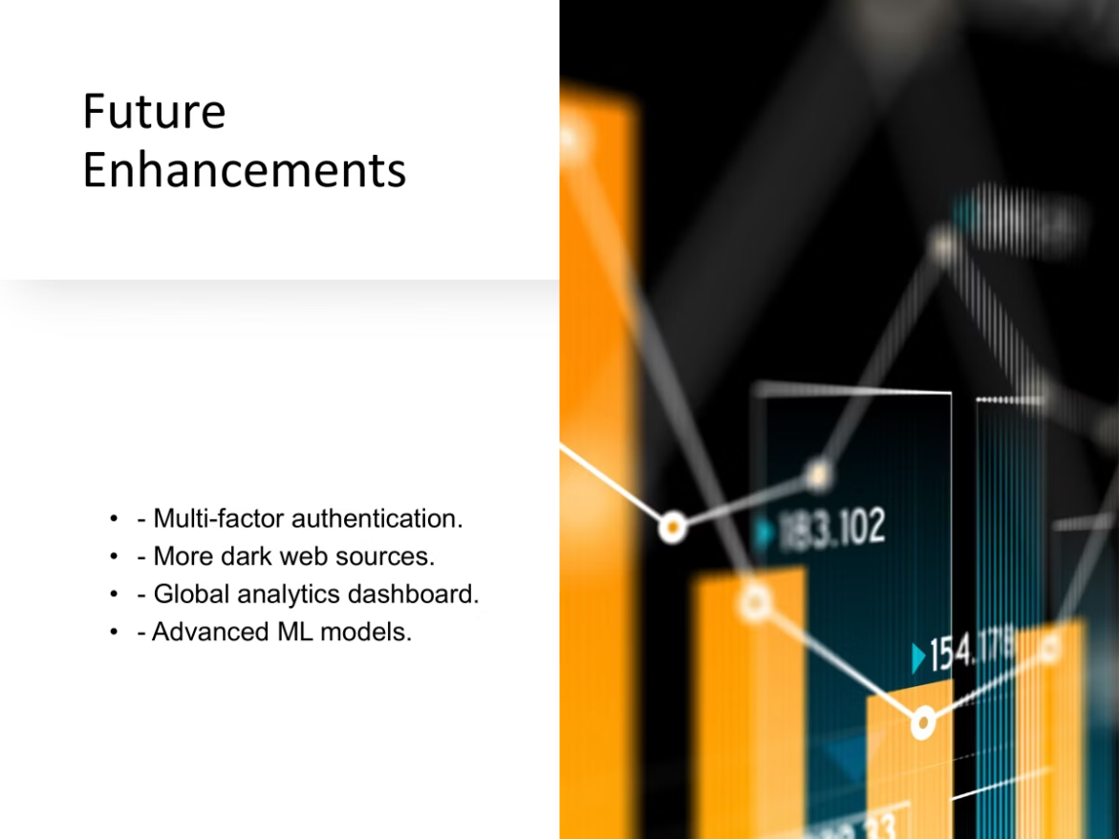

Slide 16
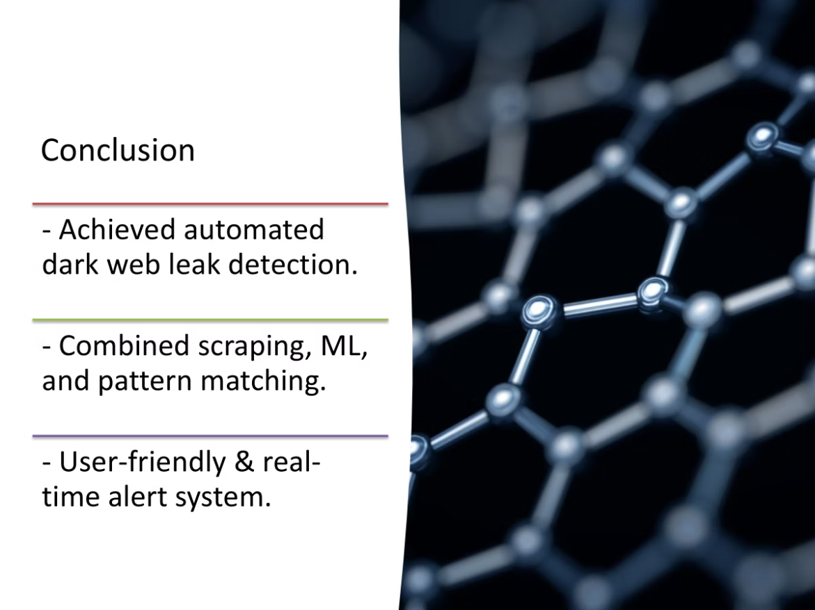

Slide 17
